Slide 1
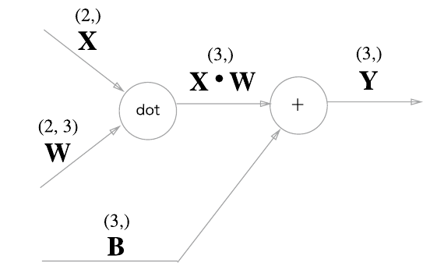
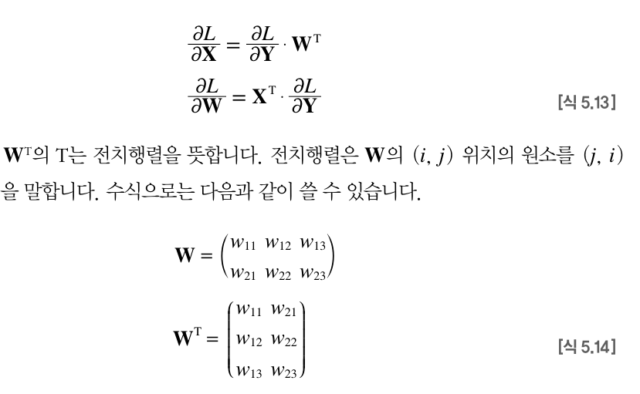
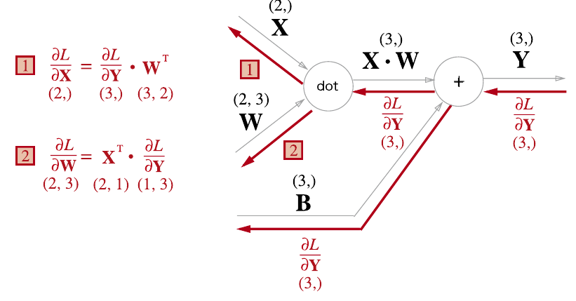
L(손실함수)

Slide 2

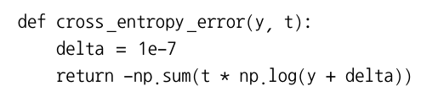


L(손실함수)

Slide 3
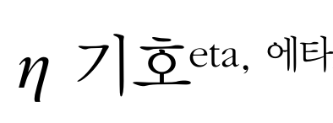
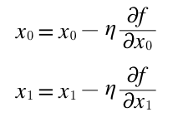


Slide 4


Slide 5
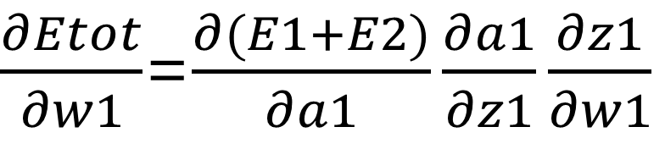
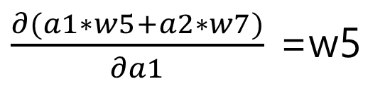
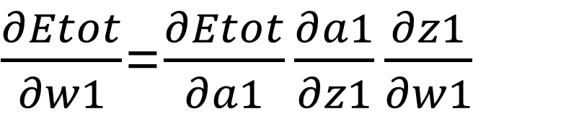
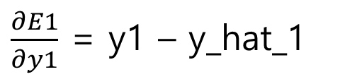
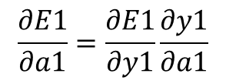
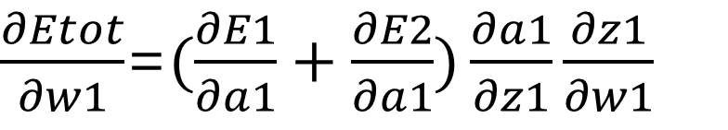
$\frac{∂Etot}{∂w1}$=$\frac{∂Etot}{∂a1}\frac{∂a1}{∂z1}\frac{∂z1}{∂w1}$
0.05
z1 | a1
0.01
0.15 w1
0.2 w2
0.25 w3
0.3 w4
0.35
0.4
0.45
0.5
y1
x1
$\frac{∂Etot}{∂w1}$=$\frac{∂(E1+E2)}{∂a1}\frac{∂a1}{∂z1}\frac{∂z1}{∂w1}$
0.1
z2 | a2
0.99
y2
$\frac{∂Etot}{∂w1}$=$(\frac{∂E1}{∂a1}+\frac{∂E2}{∂a1})\frac{∂a1}{∂z1}\frac{∂z1}{∂w1}$
x2
$$\frac{∂E1}{∂a1}=\frac{∂E1}{∂y1}\frac{∂y1}{∂a1}$$
$\frac{∂E1}{∂y1}$ = y1 – y_hat_1
$\frac{∂(a1∗w5+a2∗w7)}{∂a1}$ =w5

Slide 6
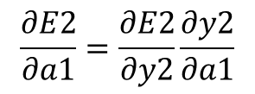
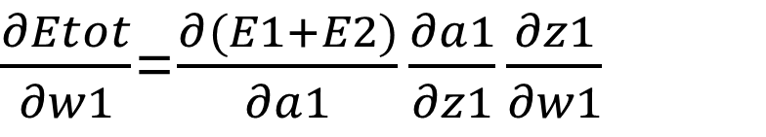
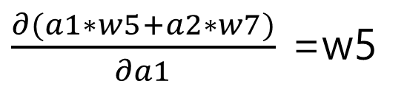

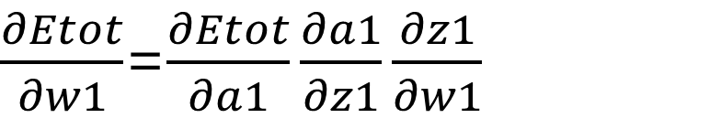
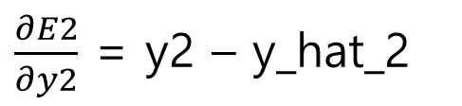
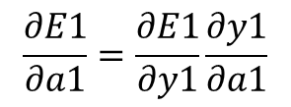
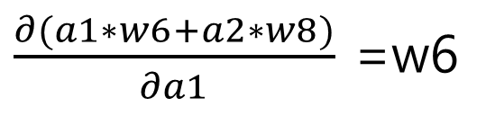
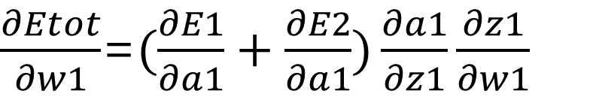
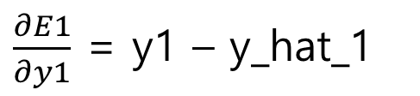
$\frac{∂Etot}{∂w1}$=$\frac{∂Etot}{∂a1}\frac{∂a1}{∂z1}\frac{∂z1}{∂w1}$
$\frac{∂Etot}{∂w1}$=$\frac{∂(E1+E2)}{∂a1}\frac{∂a1}{∂z1}\frac{∂z1}{∂w1}$
$\frac{∂Etot}{∂w1}$=$(\frac{∂E1}{∂a1}+\frac{∂E2}{∂a1})\frac{∂a1}{∂z1}\frac{∂z1}{∂w1}$
$$\frac{∂E1}{∂a1}=\frac{∂E1}{∂y1}\frac{∂y1}{∂a1}$$
$\frac{∂E1}{∂y1}$ = y1 – y_hat_1
$\frac{∂(a1∗w5+a2∗w7)}{∂a1}$ =w5
$$\frac{∂E2}{∂a1}=\frac{∂E2}{∂y2}\frac{∂y2}{∂a1}$$
$\frac{∂E2}{∂y2}$ = y2 – y_hat_2
$\frac{∂(a1∗w6+a2∗w8)}{∂a1}$ =w6
$$(w5+w6)(sigmoid\left(z1\right)∗(1−sigmoid\left(z1\right)) \frac{∂(w1∗x1+w3∗x3 )}{∂w1}$$
$$z1=w1∗x1+w3∗x3$$
$(w5+w6)(sigmoid\left(z1\right)∗(1−sigmoid\left(z1\right))$ $x1$

Slide 7
$\frac{∂Etot}{∂w1}= (w5+w6)(sigmoid\left(z1\right)∗(1−sigmoid\left(z1\right))$ $x1$
$\frac{∂Etot}{∂w3}= (w5+w6)(sigmoid\left(z1\right)∗(1−sigmoid\left(z1\right))$ $x2$
$\frac{∂Etot}{∂w2}= (w7+w8)(sigmoid\left(z2\right)∗(1−sigmoid\left(z2\right))$ $x1$
$\frac{∂Etot}{∂w4}= (w7+w8)(sigmoid\left(z2\right)∗(1−sigmoid\left(z2\right))$ $x2$

